Slide 1
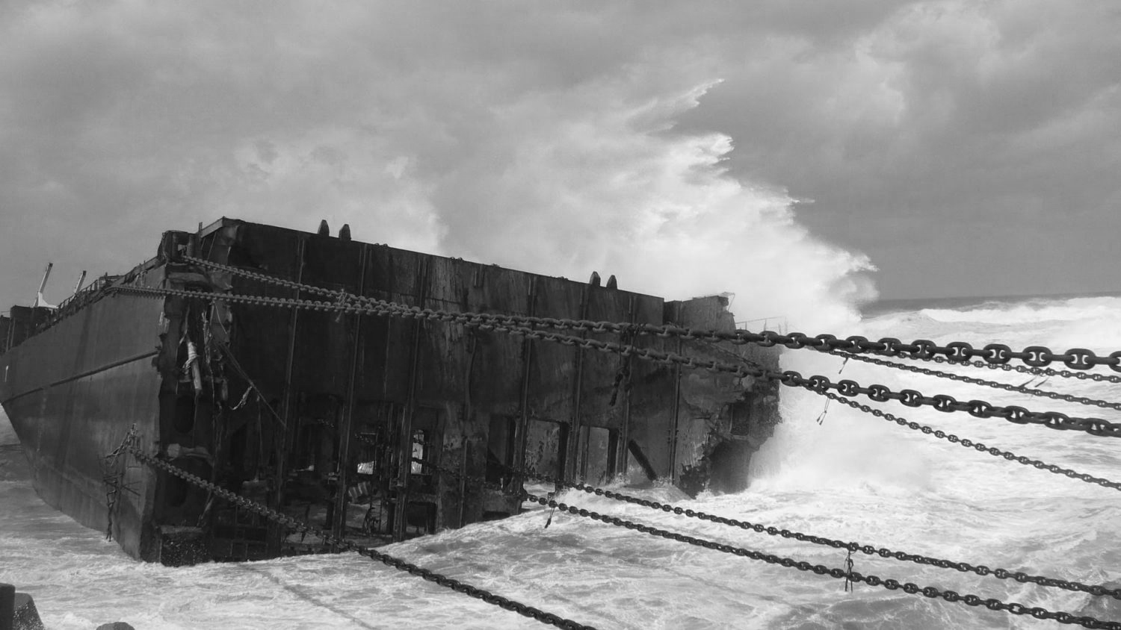

OFFSHORE TRANSPORT AND ENGINEERING LLP
Marine CONSULTANCY SERVICES

Slide 2
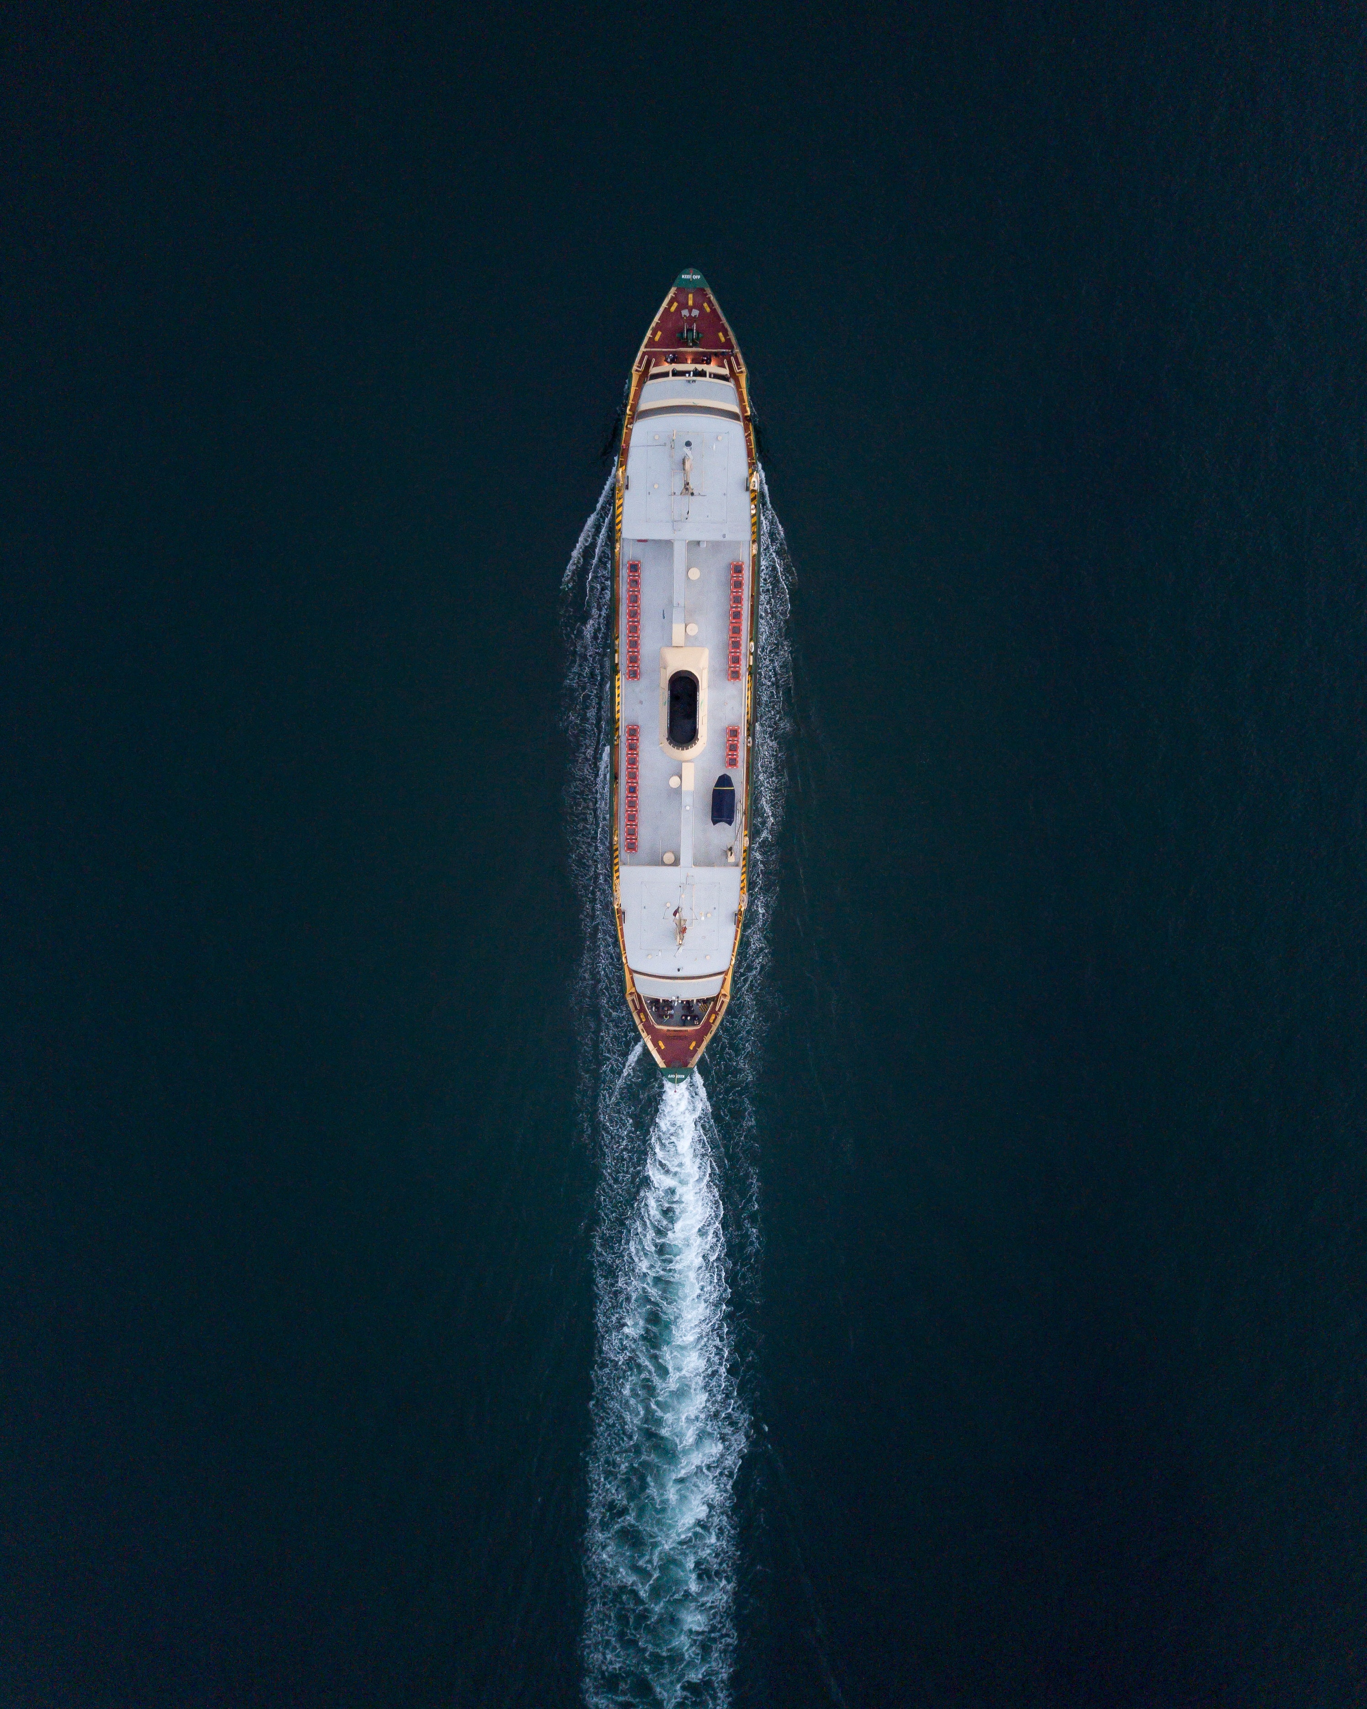



About Us
OTE is a company that offers marine, engineering and consultancy services to the Maritime, oil, gas, marine construction and power sectors along with providing real time market-leading advice and de-risking operations whilst promoting maritime commerce.
OTE also unites leading marine, engineering and adjusting consulting companies in their common commitment to driving energy transition across the marine and energy industries.
Headquartered in Mumbai, the company has an international network in marine and offshore energy hubs.
Localization, Complete teams and individual services
OTE is able to provide complete teams to take on full projects, but our experts can also be hired individually.
Our core team works closely with a network of seasoned professionals, allowing us to deliver tailor-made solutions.
Cost-effective
Business opportunities
OTE work with competitive lump sum fees or individual rates, compliant with client requirements.
Thanks to the extensive network of OTE, we can also introduce you to business opportunities and provide tendering support.

Slide 3
Solution based services
We understand our clients needs and provide “Solution based services”. In lieu of this we don’t only offer Technical but also corporate services so as to enable our clients and partners to understand the business atmospherics on ground and hence create ease of doing business.
Corporate Services:
Country representation
Taxation and GST
Corporate compliance
Banking and Project finance
Hedging currency solutions
Marketing and tendering
Local cost estimation
Technical Services:
Feasibility studies
Surveys and audits
Marine engineering
Salvage
Decomm
Heavy lift and transport
Chartering and Brokerage
Marine Law

Slide 4

Our Approach
OTE delivers high quality maritime and offshore consultancy and support services. Covering savage, transport and decommissioning assignments all over the world.
OTE’s core business is to assist companies with specialized knowledge and expertise, primarily w.r.t marine and transport projects.

Slide 5

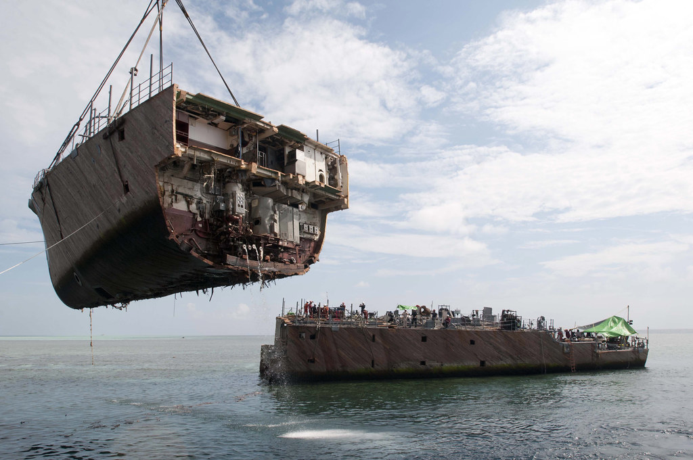

Our Expertise
Emergency Response
OTE provide expert assistance when your vessels are in distress. Our team consists of experienced Naval Architects and Salvage Masters with support from other mariners to ensure that owners have access to the best advice when they most need it. We act fast, with a hands-on approach.

Slide 6


Expertise
Our service can be tailored to precisely match your needs and typically includes:
24/365
Enquiry
Responsive advice
24/365 availability to give real-time support
Integrated as part of client/ Partner company policies
OTE delivers high quality maritime and offshore consultancy and support services. Covering salvage, transport and decommissioning assignments all over the world.
OTE’s core business is to assist companies with specialized knowledge and expertise, primarily regarding salvage and transport projects.

Slide 7
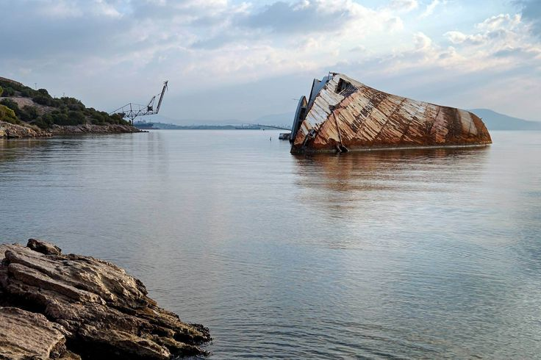
CONTACT
Offshore Transport and Engineering LLP
105 A wing, Raheja Plaza Building
Off New Link Road, Shah Industrial Estate
Andheri (W), Mumbai
admin@traneng.com
gbakshi@traneng.com
+91 22 49621291
24x7: +91 9920222233

Slide 8
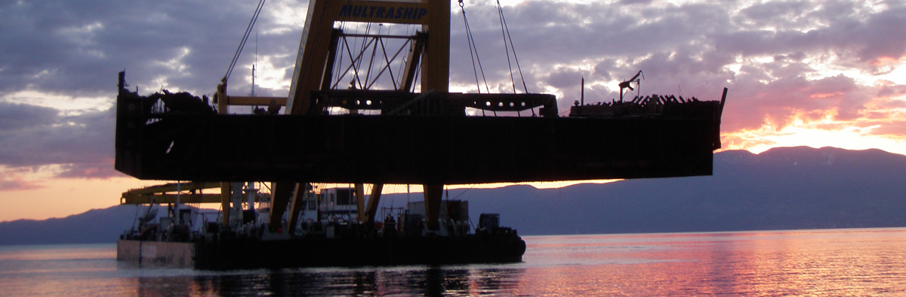
THANK YOU

